Slide 1



Sign Language to Audio and Text Conversion
STUDENT DETAILS
ACADEMIC DETAILS
Name: [Your Name Here]
Guide: [Prof. Name Here]
Register No: [12345678]
College: [College Name Here]
Dept: Computer Science & Engg.
Year: 2025-2026

Slide 2

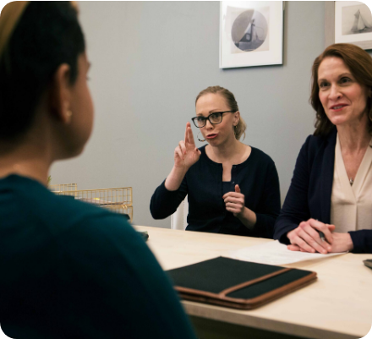
Project Outline
The Problem
Communication between the deaf/mute community and the general population is severely limited by a lack of sign language understanding, leading to social isolation.
Our Solution
Develop an intelligent Translation System.
Convert gestures to Readable Text (Subtitles).
Synthesize Audio Speech output.
Generate conversation Documents.

Slide 3





Objectives
Visual Recognition
Intelligent Translation
Implement robust Computer Vision to track hand landmarks via webcam in real-time.
Use ML algorithms to accurately map complex gestures to alphabets and words.
Audio Synthesis
Accessibility
Bridge the gap by converting recognised text into audible human speech.
Create an affordable, software-based solution requiring no expensive hardware.

Slide 4


Technical Domain
PRIMARY DOMAIN
Sub-Domains
Machine Learning & AI
Computer Vision: Image acquisition & processing.
Deep Learning: Neural Networks for pattern matching.
Speech Processing: TTS (Text-to-Speech) engines.
HCI: Human-Computer Interaction design.

Slide 5






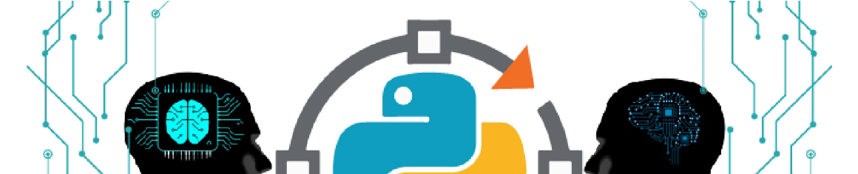
System Overview
Capture
Track
Classify
Translate
Speak
Webcam Input
MediaPipe Landmarks
Prediction Model
Text Generation
Audio Output

Slide 6


Tools & Technologies
Core Logic
Machine Learning
Python 3.x
TensorFlow & Keras
The backbone of our backend and ML processing.
For building and training the gesture recognition model.
Vision & Speech
Interface
OpenCV & MediaPipe
HTML/CSS or Android XML
pyttsx3 / gTTS for Audio synthesis.
User-friendly frontend for interaction.

Slide 7


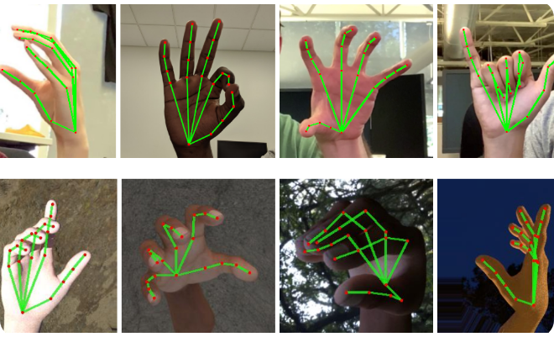
Expected Outcome
Real-time Detection: High FPS tracking with minimal latency.
Accuracy: Precise translation of alphabets and common words.
Feedback: Instant visual text and clear audio output.
Social Good: A working prototype that aids inclusivity.

Slide 8
Conclusion
"This project bridges the silence using code. By leveraging Computer Vision and AI, we are creating a tool that transforms gestures into voice, fostering a more inclusive world."

Slide 9



Image Sources
https://sorenson.com/wp-content/uploads/2025/01/on-site-interpreter-scaled.jpg
Source: sorenson.com
https://api.edoxi.com/assets/studyhub/ezgif_com-gif-maker_(24).webp
Source: www.edoxi.com
https://1.bp.blogspot.com/-8SxmsK5VoJ0/XVrTpMrJDFI/AAAAAAAAEiM/nAa3vuj8a2sjgEPAeMKXD4m09yKUgjVIQCLcBGAs/s1600/Screenshot%2B2019-08-19%2Bat%2B9.51.25%2BAM.png
Source: research.google

